Slide 1

Online pedagogy and sharing practice
Rafa Canet

Slide 2
Learning outcomes for this sharing practice session:
Develop an understanding of effective online communication.
Develop an understanding of how different learners may feel when asked to participate in a forum, online activity, or an online room session.
Develop realistic expectations for learners’ participation in online learning activities, and online room sessions of different group sizes.
Explore further key strategies which will help you with your teaching in a blended or distance learning model of delivery.

Slide 3

How does it feel?
Use the Chat and express how online delivery feels to you? If you have managed to overcome some of those feelings, share if you don’t mind what you did.
Discuss in groups (Breakout rooms) – share practice:
Do you recognise or remember experiencing any of these emotions yourself as a learner (eg as a student or during a professional development course)?
Would students nowadays using different online communications media have similar or different reactions and how could this affect their ability to learn?
How could you, as their tutor, help them overcome some of the more negative emotions in order to encourage learning?
You will need a note taker in your group to capture your findings

Slide 4

SWOT (two parts)
Discuss:
• Initial assessment (from a learner and tutor perspective):
- how can it be conducted – medium
- Staffing
- Recording the results
- Recommendations – IAG
- Induction – online? – what does it look like.
•Teaching Staff - SWOT - analysis – setting own targets and overcoming own barriers and fears .

Slide 5
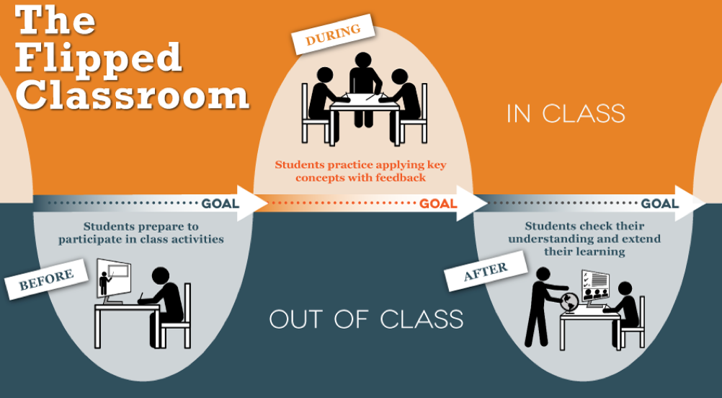
Flipped teaching - How relevant is it in the current context?

Slide 6
Before the session you were asked to read “Social presence in online learning communities” by Karen Kear. Bear that article in mind when taking part on the following discussion.
Discuss:
• What is social presence?
• Is it the same as teaching presence?
• Do they need to go hand in hand?
• What is their impact on leaning?

Slide 7
In your breakout rooms you have to discuss the model produced by Andrew Salcido and Jessica Cole. “Best Practices for Teaching Online.”
Consider the following:
How different is it from what you were doing?
What are the challenges that you can foresee?
Are the differences in your approach to teaching face to face or this online framework?

Slide 8
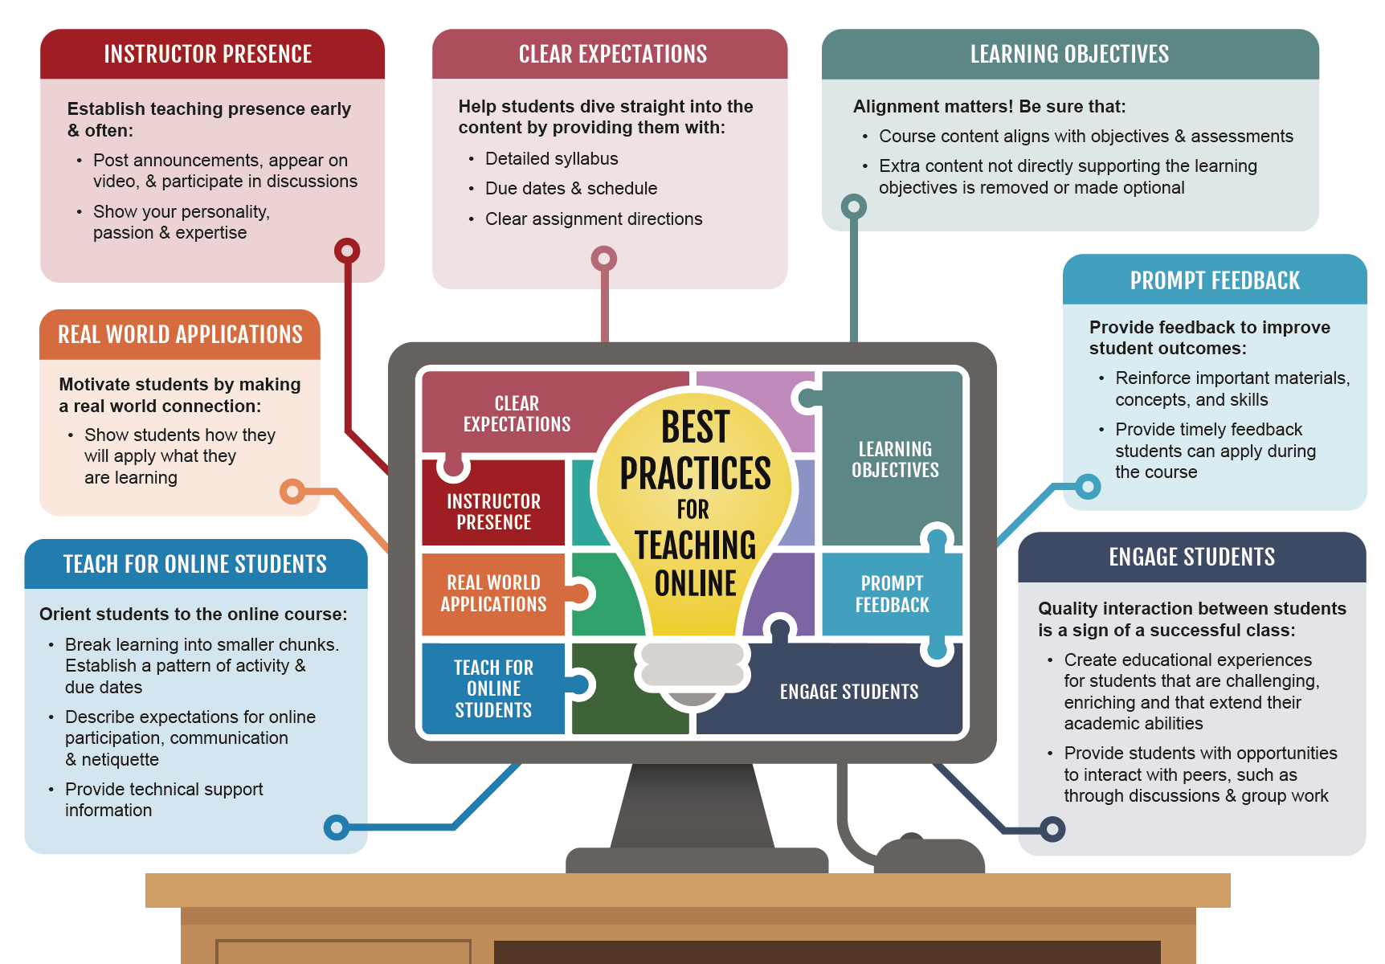
Andrew Salcido and Jessica Cole. “Best Practices for Teaching Online.” TeachOnline, 22 Aug. 2019, teachonline.asu.edu/2018/09/best-practices-for-teaching-online/.

Slide 9
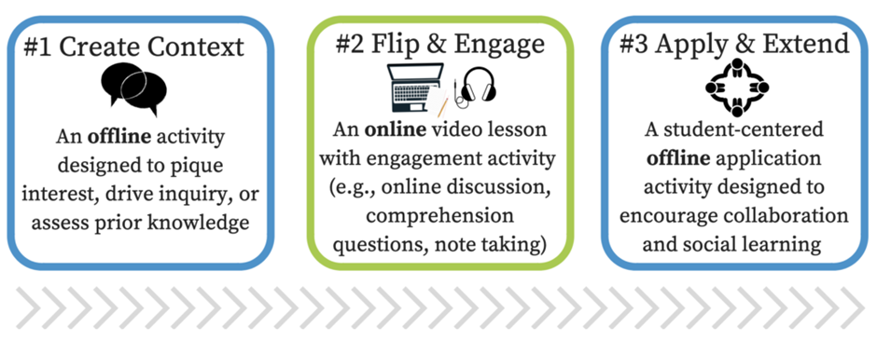
Practising your online classroom communication/ teaching skills:
You have been assigned your own google classroom. Try out your pedagogic ideas for communicating / teaching in online classroom lessons.
Devise an activity for your own teaching in online classroom which uses one of the techniques you saw in the video recordings.
Develop the activity, perhaps including using features of the online tools available to you by testing it in your classroom.

Slide 10

1 – Prepare
2 – Innovate
3 – Keep calm
Remember

