Slide 1

Skills for Life: a new strategy for English, maths, ESOL and digital
Learning from the past to improve the future
Next Stage 2021-2031
https://fetl.org.uk
Use #SFL21to31 to let others know what you intend to do

Slide 2
Commit now
Today is about taking action, please think about what you can do to support adults improving their English, maths, ESOL and digital skills.
Use twitter #SFL21to31 to let others know what you intend to do

Slide 3
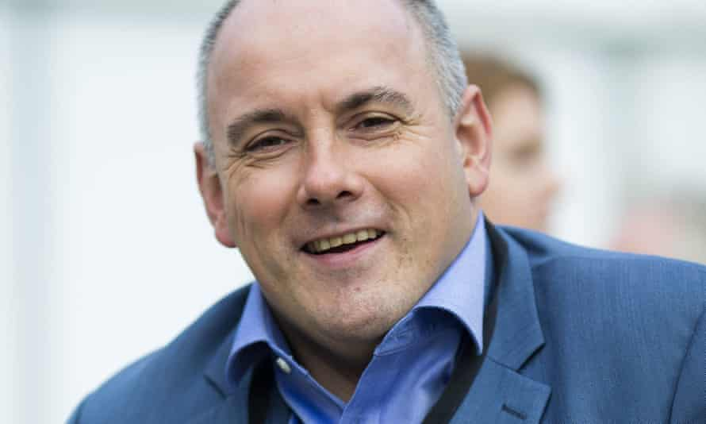
Opening
Rt. Hon. Robert Halfon MP
Chair of the Education Select Committee

Slide 4
Learner Journey
Alex Stevenson from Learning and Work
talks with
Hannah Wilkins about her learning journey

Slide 5

Overcoming Difficulties in Life
Jay Blades, Presenter Repair Shop

Slide 6
Why are we here today?
The Problem/Challenge and Scale in 2000
Large Scale - Up to 7 million below level 1 in literacy and more in numeracy
Culture and Learner Motivation
Quality of Provision and Learner Perception
The Problem/Challenge and Scale in 2021
Up to 9 million with poor basic literacy and more in numeracy
17.3 million needing digital skills for work

Slide 7
Participation Freefall
2001–2011
External evaluation reported between 2001-2011 that some 14 million participated in adult literacy and numeracy activities with over 8 million qualifications being achieved
2009
Annual participation in English and maths courses peaked in 2009 then settled at around 800,000
2016–2017
In 2016/17, participation decreased 6% to 755,300 (down from 803,800 in 2015/16)
2017–2018
In 2017/18 there was a further 12.1% decrease to 664,200
2018–2019
That downward trend has continued: in 2018/19, 573,500 people participated and in 2019/20 this had fallen to 479,300
2019–2020
Since 2017/18 adult participation in English has dropped from 445,800 to 288,200 in 2019/20

Slide 8
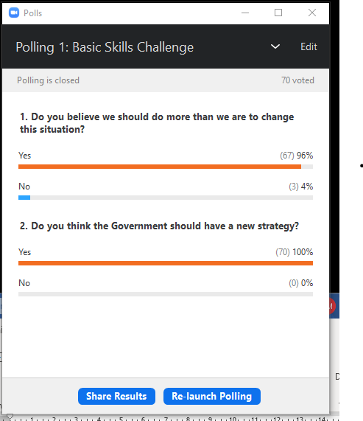
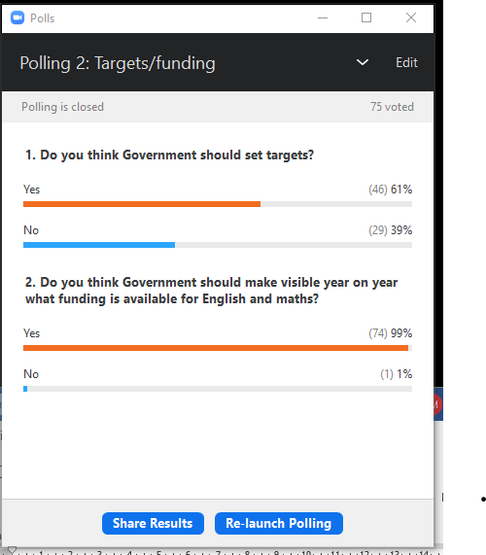
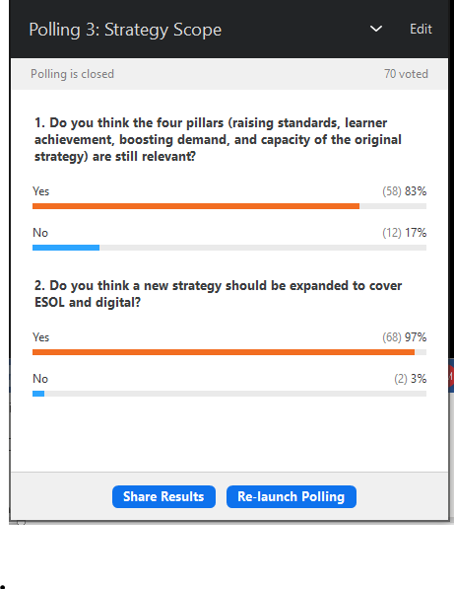
Results of our consultation

Slide 9
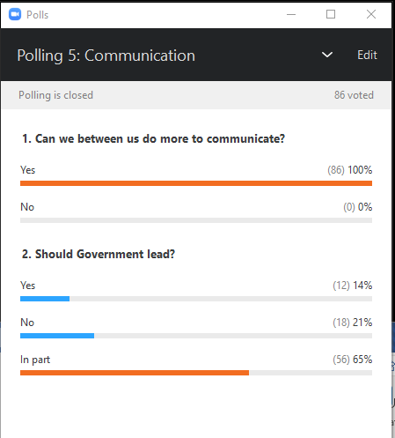
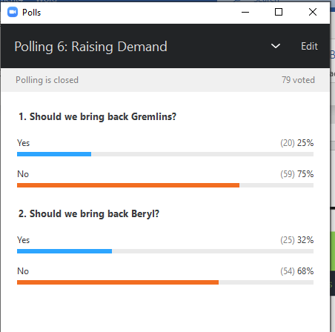
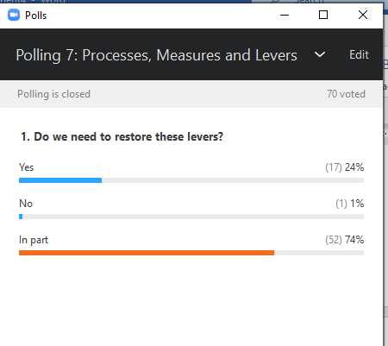

Slide 10
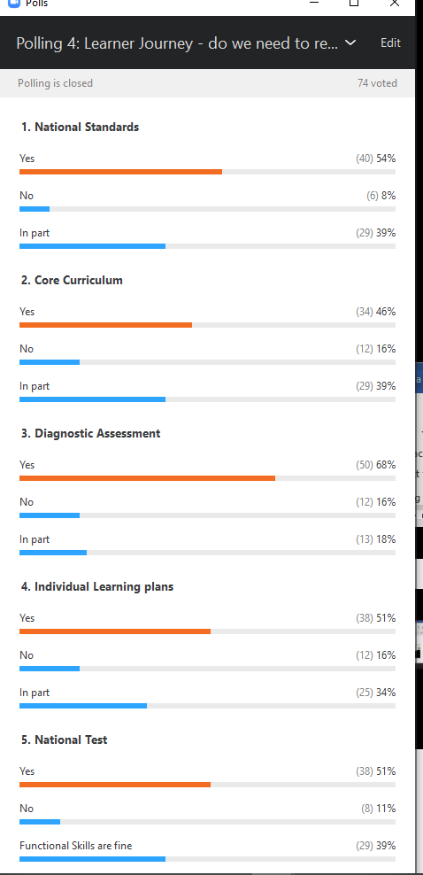
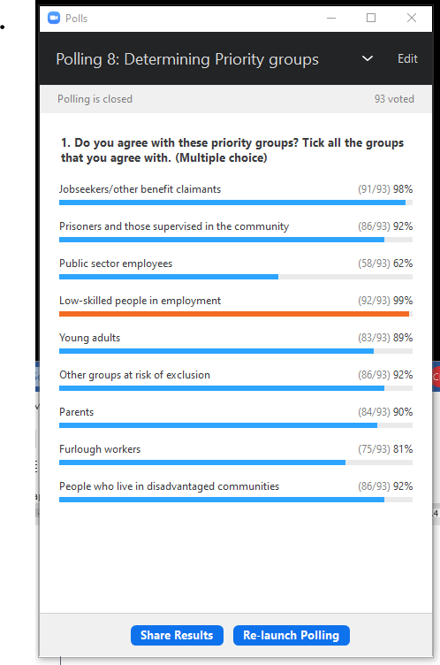

Slide 11
What worked and why
Endorsement from the top
A whole-government approach to delivery
Clear and measured targets, goals and objectives
Mainstreaming within the FE sector
Working together with delivery partners, stakeholders, teachers, learners and employers to improve the learner experience
Ensuring quality by setting clear standards and development of a basic curriculum, a national test and inspection
Emphasis on building capacity and supporting teachers
Use of the mainstream media and relentless communication
Working with initiatives that had the same goals
Underpinned by robust programme management and accountability

Slide 12
Two important sub-programmes
Family Learning
ESOL

Slide 13
What we need to do together
Collective leadership
New strategy
Underpinning delivery plan
Whole-government approach to delivery
Regional and national infrastructure should fund and promote basic skills
Enhanced workplace and unemployment offer
Rebalancing the post-18 funding envelope
Establish a realistic funding level
Revise and clarify the ‘stepping stone’ concept of funding
A quality offer
Supporting the front line
Clear signposting to courses
Use of the media
Universal roll-out of family learning
Review the role of GCSEs

Slide 14
The sector has come together to commit to action
Mark Dawe, The Skills Network
Helen George, MCAs
David Russell, ETF
Jane Hickie, AELP
Ken Sargison, Former Deloitte Partner –SFL employer champion
Lisa Capper, NACRO
Stephen Evans, Learning and Work
Dipa Ganguli, HOLEX
Simon Parkinson, WEA
David Hughes, AoC

Slide 15
Learner journey: Sally Eldridge, Thurrock Adult Community College
My experience of school wasn’t great and I struggled with being bullied and couldn’t wait to leave and after some hard life experiences my confidence was at an all-time low.
I decided that I needed to improve my English, maths and IT skills to improve my job prospects. It took courage to go into the Community College to enquire.
Once I started you couldn’t stop me. She encouraged me to become a sessional tutor at TACC and I completed a qualification in education and training.
In 2013 I became a learning support assistant in a secondary school. I enjoyed working with the students but I had always wanted to work at TACC again, so when I saw a job advert for a learning support coordinator and I got the job.

