Slide 1

Digital Champions Event
10th March 2022
Jade Sampson
&
Tony Vidal

Slide 2
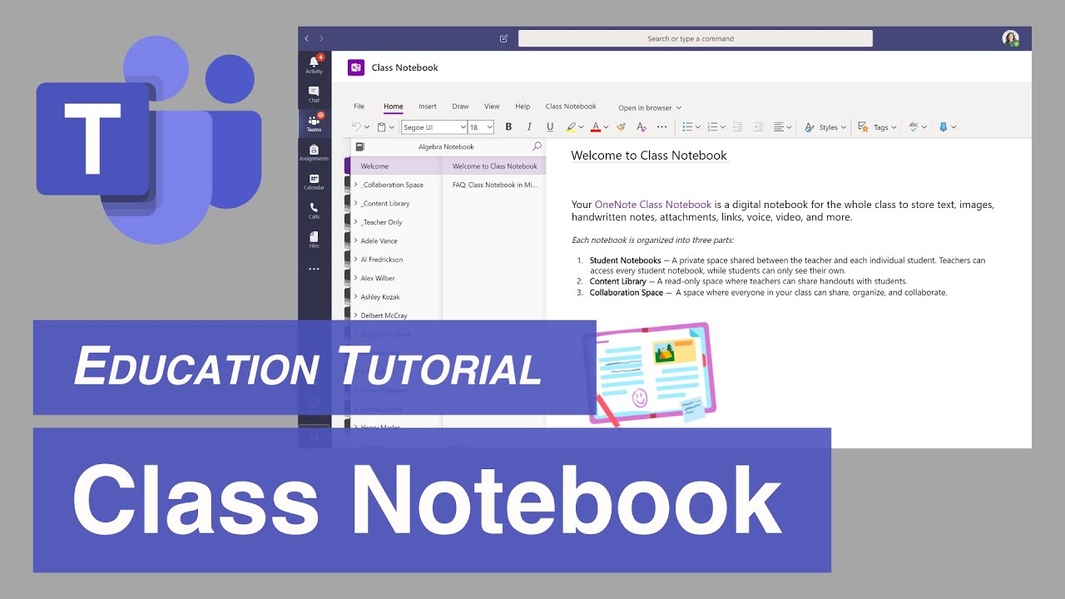
Top Tec Tips Class notebook
Migration from Google Docs to Microsoft office 365
Class notebook
Different medium
Collaboration
Differentiation
Peer working
Group working
Individual
Provide 1-1 support

Slide 3
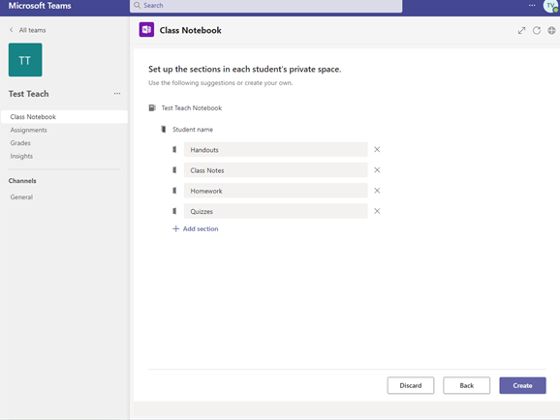

Slide 4
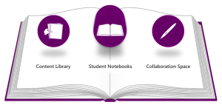
Collaboration Space
Open space for all
Learners & Teachers
Multiple users at one time
Share ideas
Support each other

Slide 5
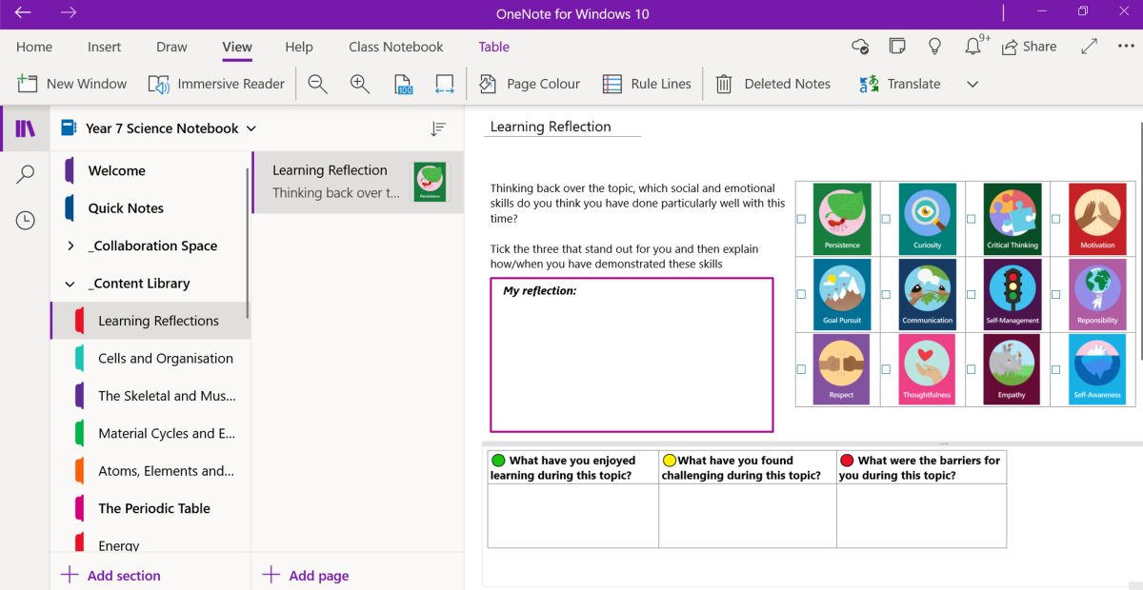
Content Library
It is a filing cabinet
Storage for files
Media
Worksheets
Class notes
In lesson whiteboard notes

Slide 6
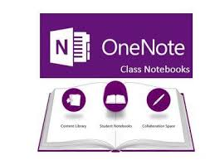
Teacher only Section
The teacher area
Private space
Storage
Curriculum planning
Activities prior to sending to the content library
Lesson plan notes

Slide 7
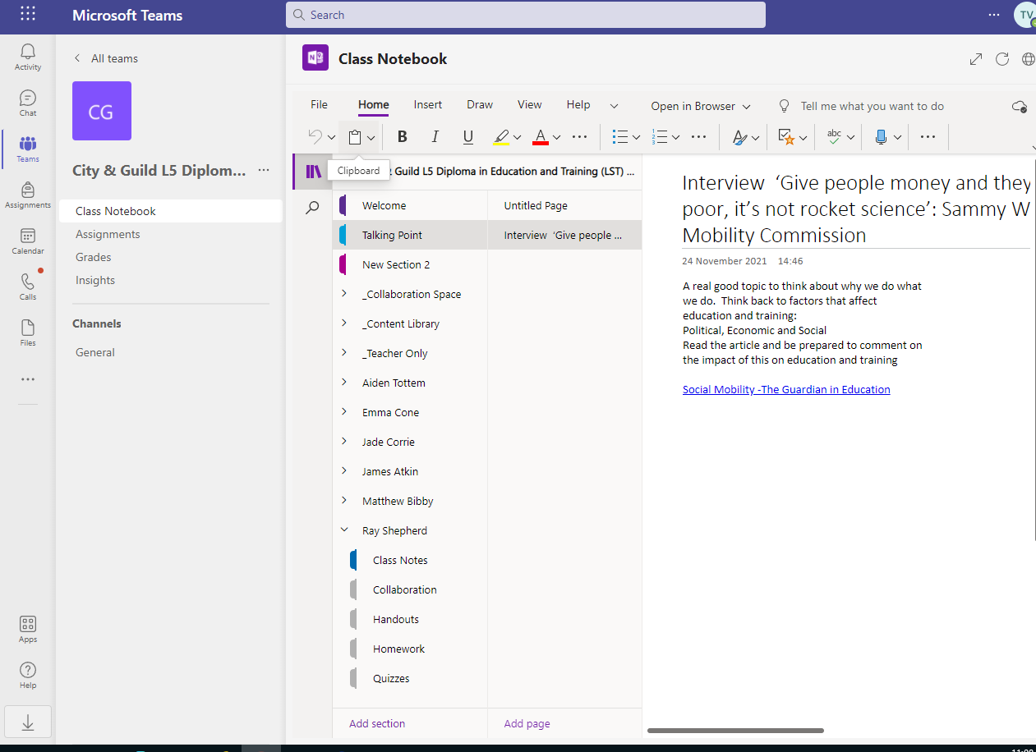

Setting Tasks
Great for setting tasks
Creating talking points
Feeds
Hyper links
Provides a digital portfolio
Learning
Maths

Slide 8
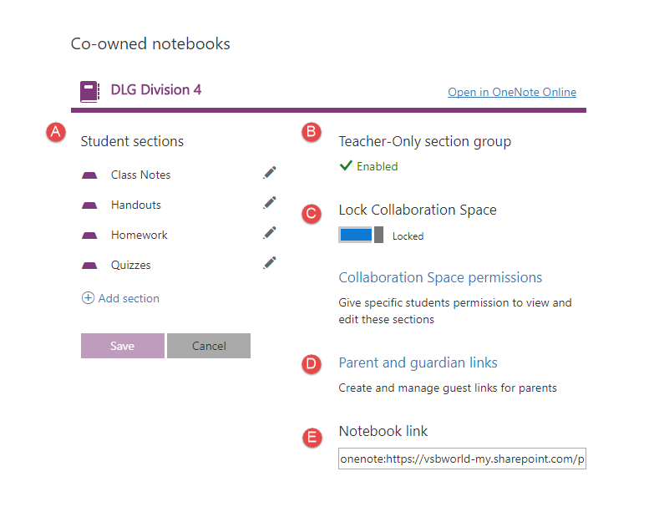
Homework Tab
Great for setting homework
Allows for differentiation
Private personal to each learner
Complete the work
Real time
Feedback

